Slide 1
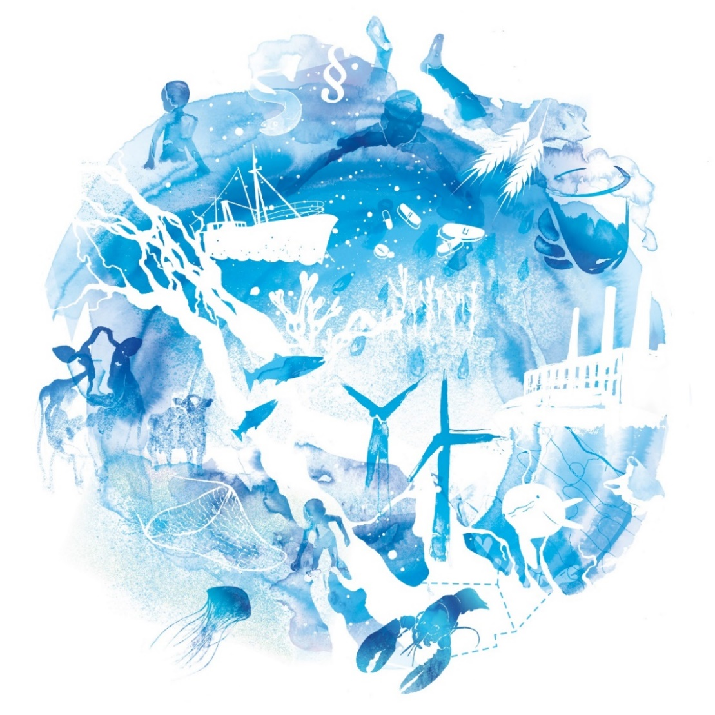
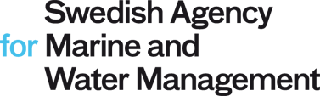
Source to Sea Opportunities
in the Asia-Pacific Region
The 3rd Asia-Pacific Water Summit
11-12 December, 2017
Jakob Granit, PhD
Director General
Swedish Agency for
Marine and Water Management
Notes:
Central government agency, 2011
Sorts under the Ministry of the Environment and Energy
Coordinate, guide, finance & implement
5 Water Management Agencies
3 Sea basin planning management districts
Fisheries management
Environmental monitoring & research
International development

Slide 2
What we want

Slide 3
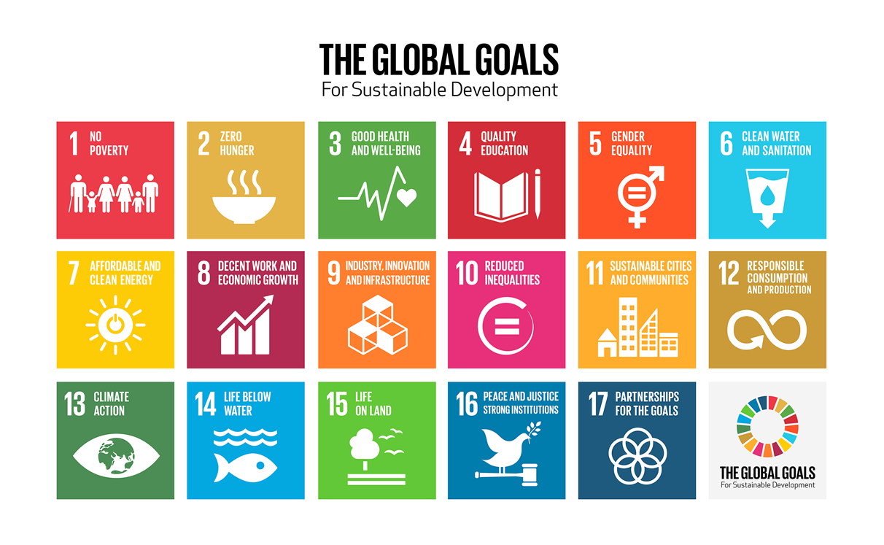
Notes:
How do we acheive the goals and how do they connect?
An holistic approach of development is critical to sustainable socie-economic development
Focus on
Goal 15
Goal 6
Goal 14
And goal 17
To achieve goal 1 & 2
With linkages to goal 13

Slide 4
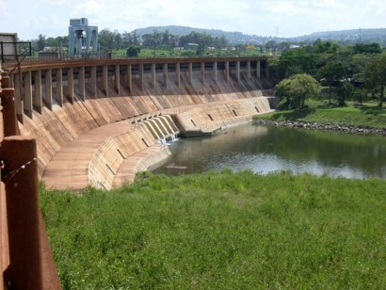
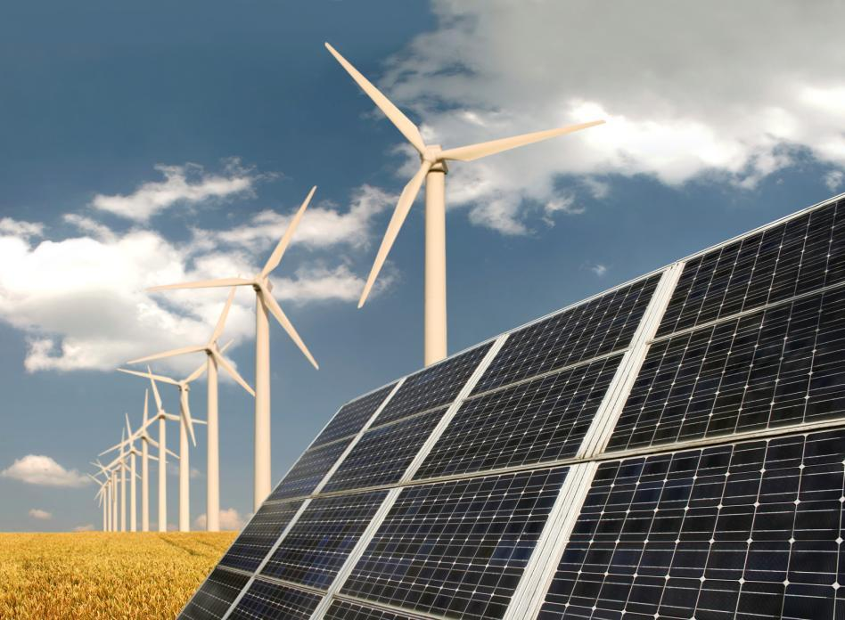
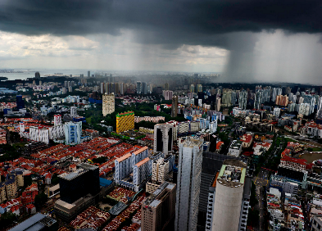
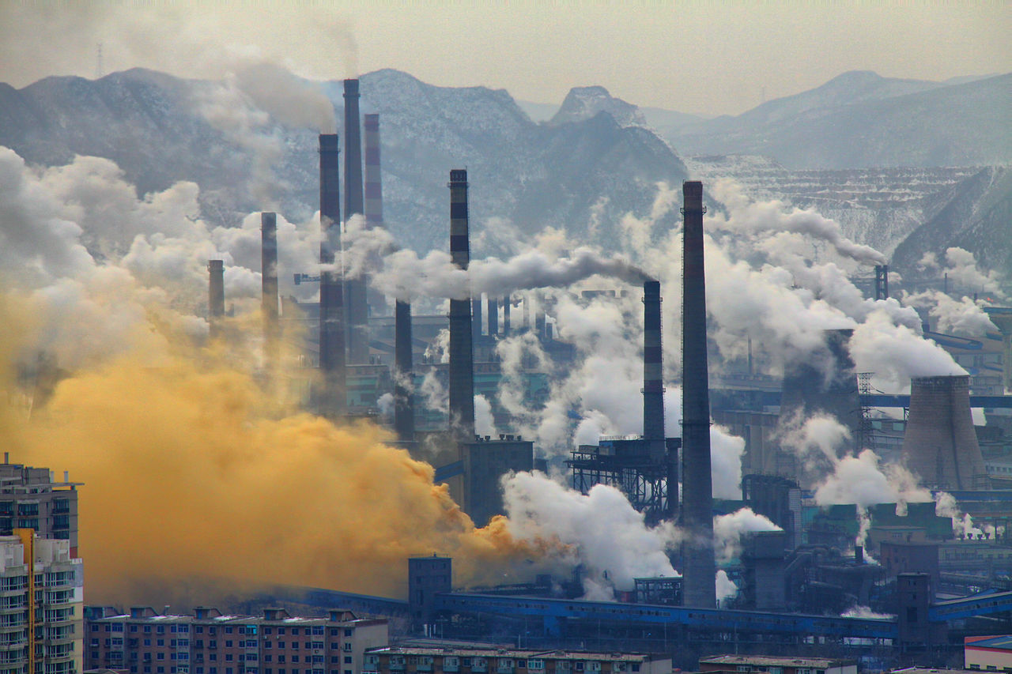
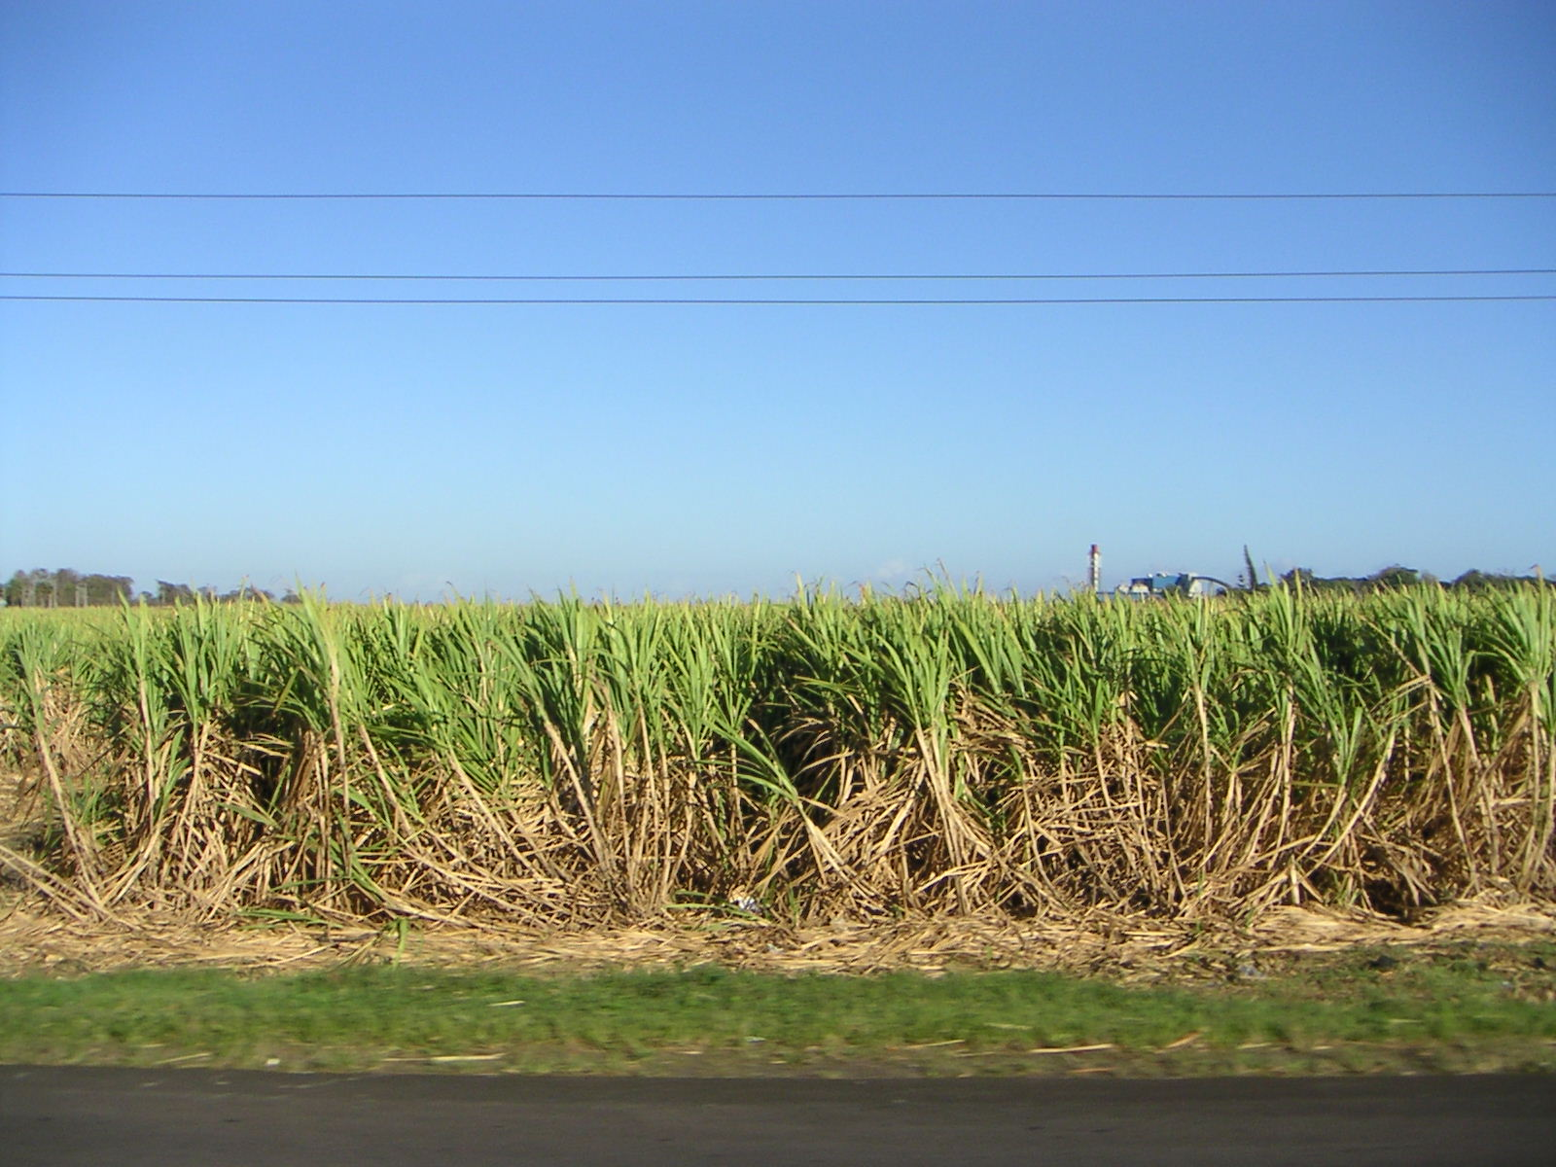
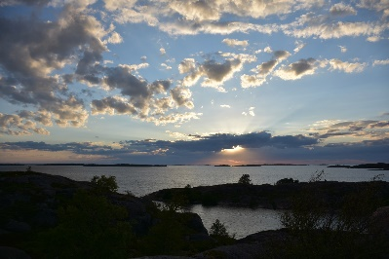
A green economy: Water-Energy-Food-Ecosystem-Nexus
Energy
production
Primary production
Industry & urbanization
Tradeoffs
&
synergies
Ecosystem services
Based on Phillips, et.al. (2008).
Söderbaum & Granit 2014, the Political Economy of Regionalism
Notes:
Dynamic systems: political economic considerations global,
regional & local / institutions & markets / incentives & behaviour
Security in each sector
Messy problem, messy decision making
Intensify knowledge, improve decisionmaking, uncertainty
Renewable Energy production – hydropower, cooling
Industry – water supply and sanitation, water for industry, water treatment,
Primary production – water for agriculture, aquaculture in land based systems, irrigation and drainage
Ecosystem services – water purification, flood control, drought control, habitats for fish, aesthtic and cultural values,

Slide 5
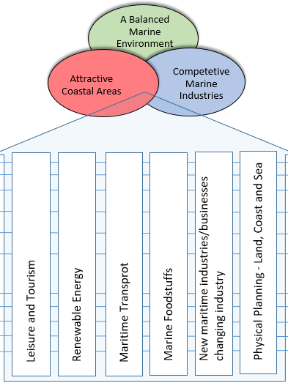
A blue economy: Sustainable development of maritime industries
Swedish Maritime Strategy 2015
Notes:
The Swedish Agency for Marine and Water Management
Swedish Agency for Economic and Regional Growth
The Swedish Transport Agency
The Swedish Board of Agriculture
The Swedish Energy Agency
The Swedish National Board of Housing, Building and Planning
“ A competitive, innovative and sustainable maritime sector can contribute to increased employment, reduced environmental impact and an attractive living environment.” The Swedish Maritime Strategy
Face pressure from:
Extensive economic activities
Rapid urban area expansion
Upstream pollution
Increased frequency of extreme weather events
Salt water intrusion
Coastal zone erosion
flooding
Increasing water temperatures
Sea level rise
Acidification
Unsustainable fishing practices
Rapid change in marine habitats

Slide 6
What can happen?

Slide 7
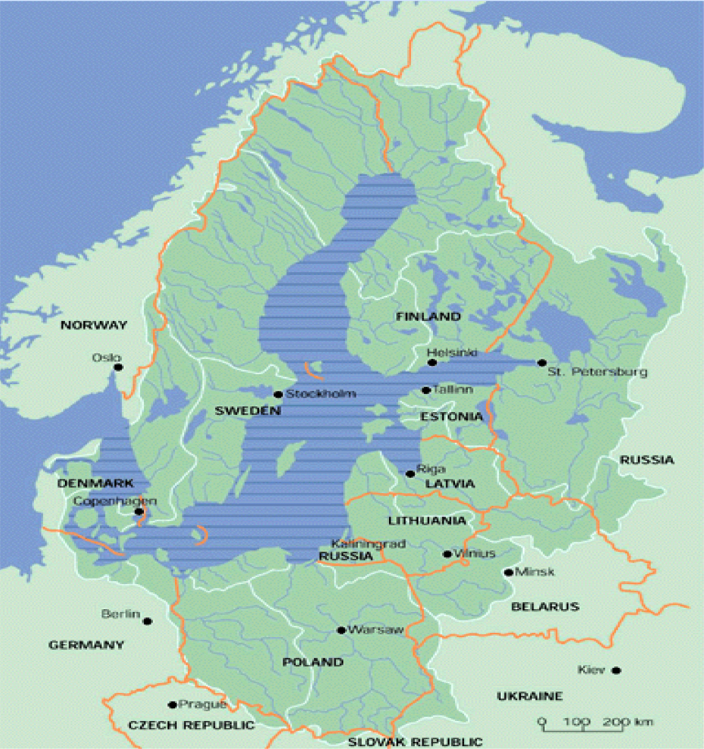
The Baltic Sea Region
14 Basin countries
9 coastal states
10 EU member states
(8 coastal)
> 85 million people in the basin
Physical facts
Drainage area 1.7 million km²
Sea area: 0,4 million km²

Slide 8
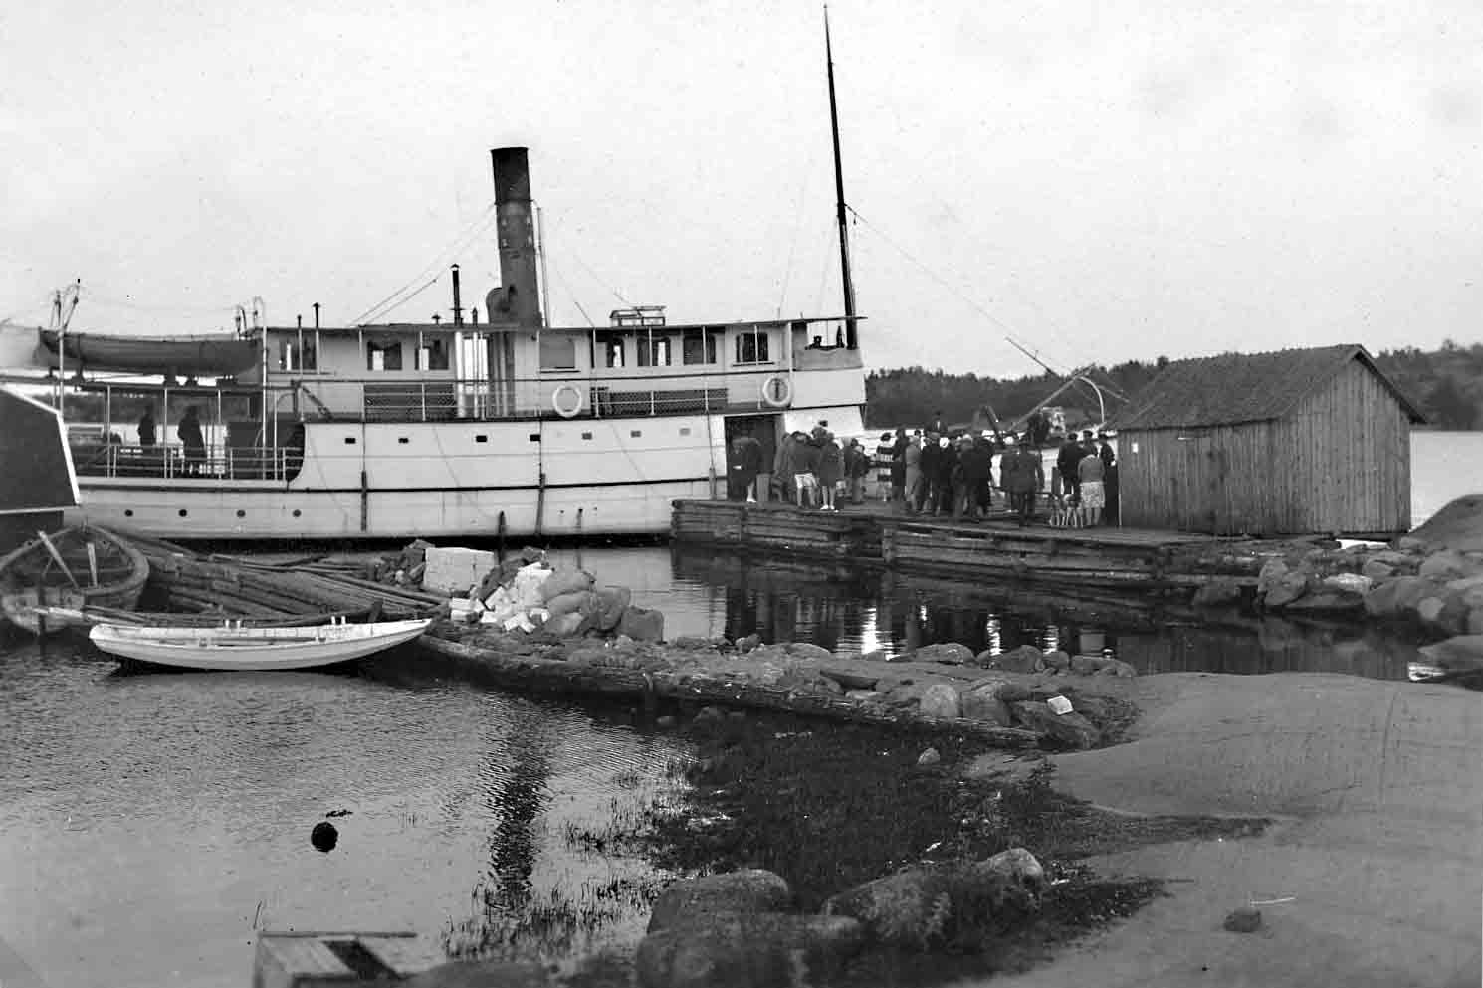
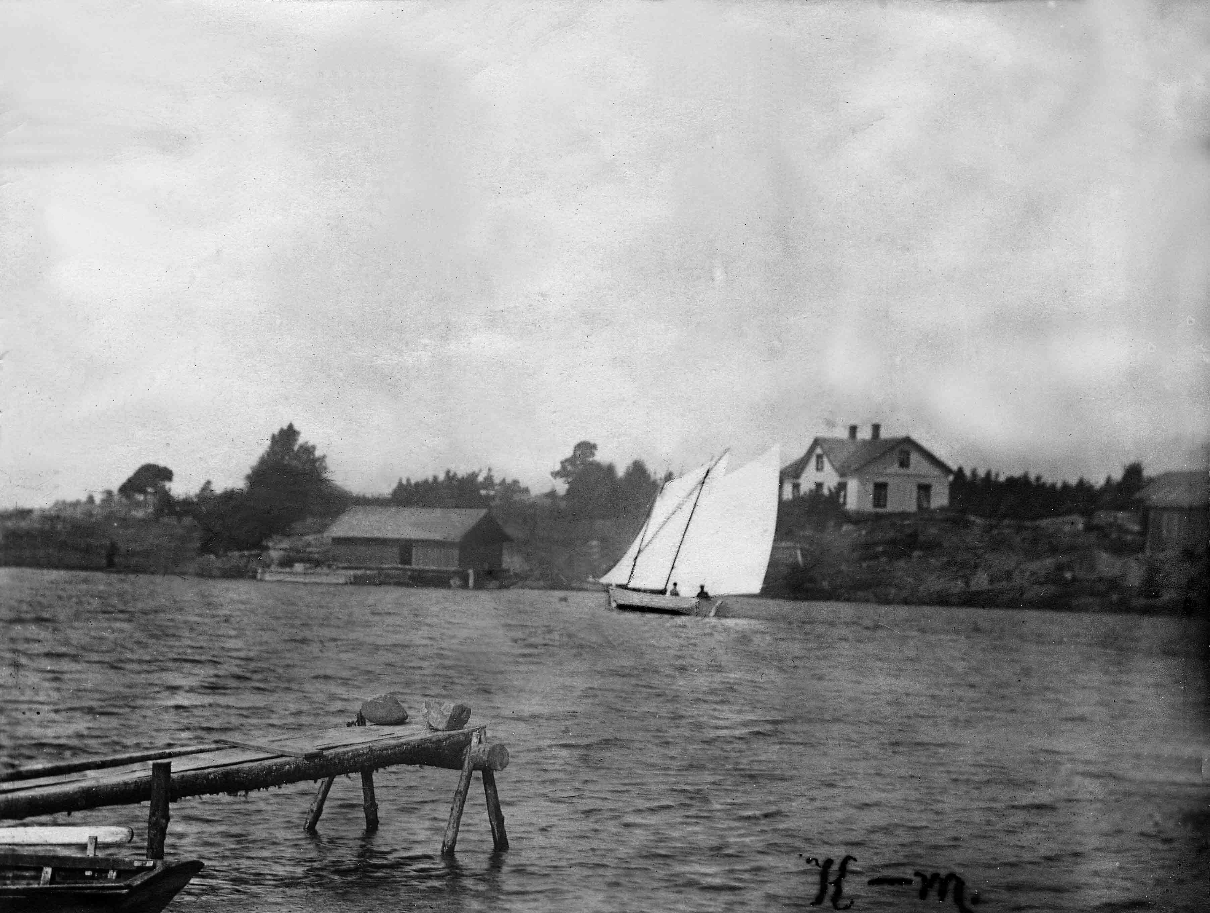
Environmental status of the Baltic Sea in the 1950s
Ecosystem did not show change due to anthropogenic pressure
  Good visibility and more nutrient poor marine waters
Smaller scale agriculture and fisheries
Solid waste management limited
  Dumping of waste occurred
  Solid, chemical and radioactive waste

Slide 9
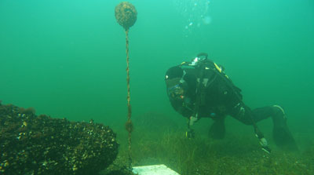
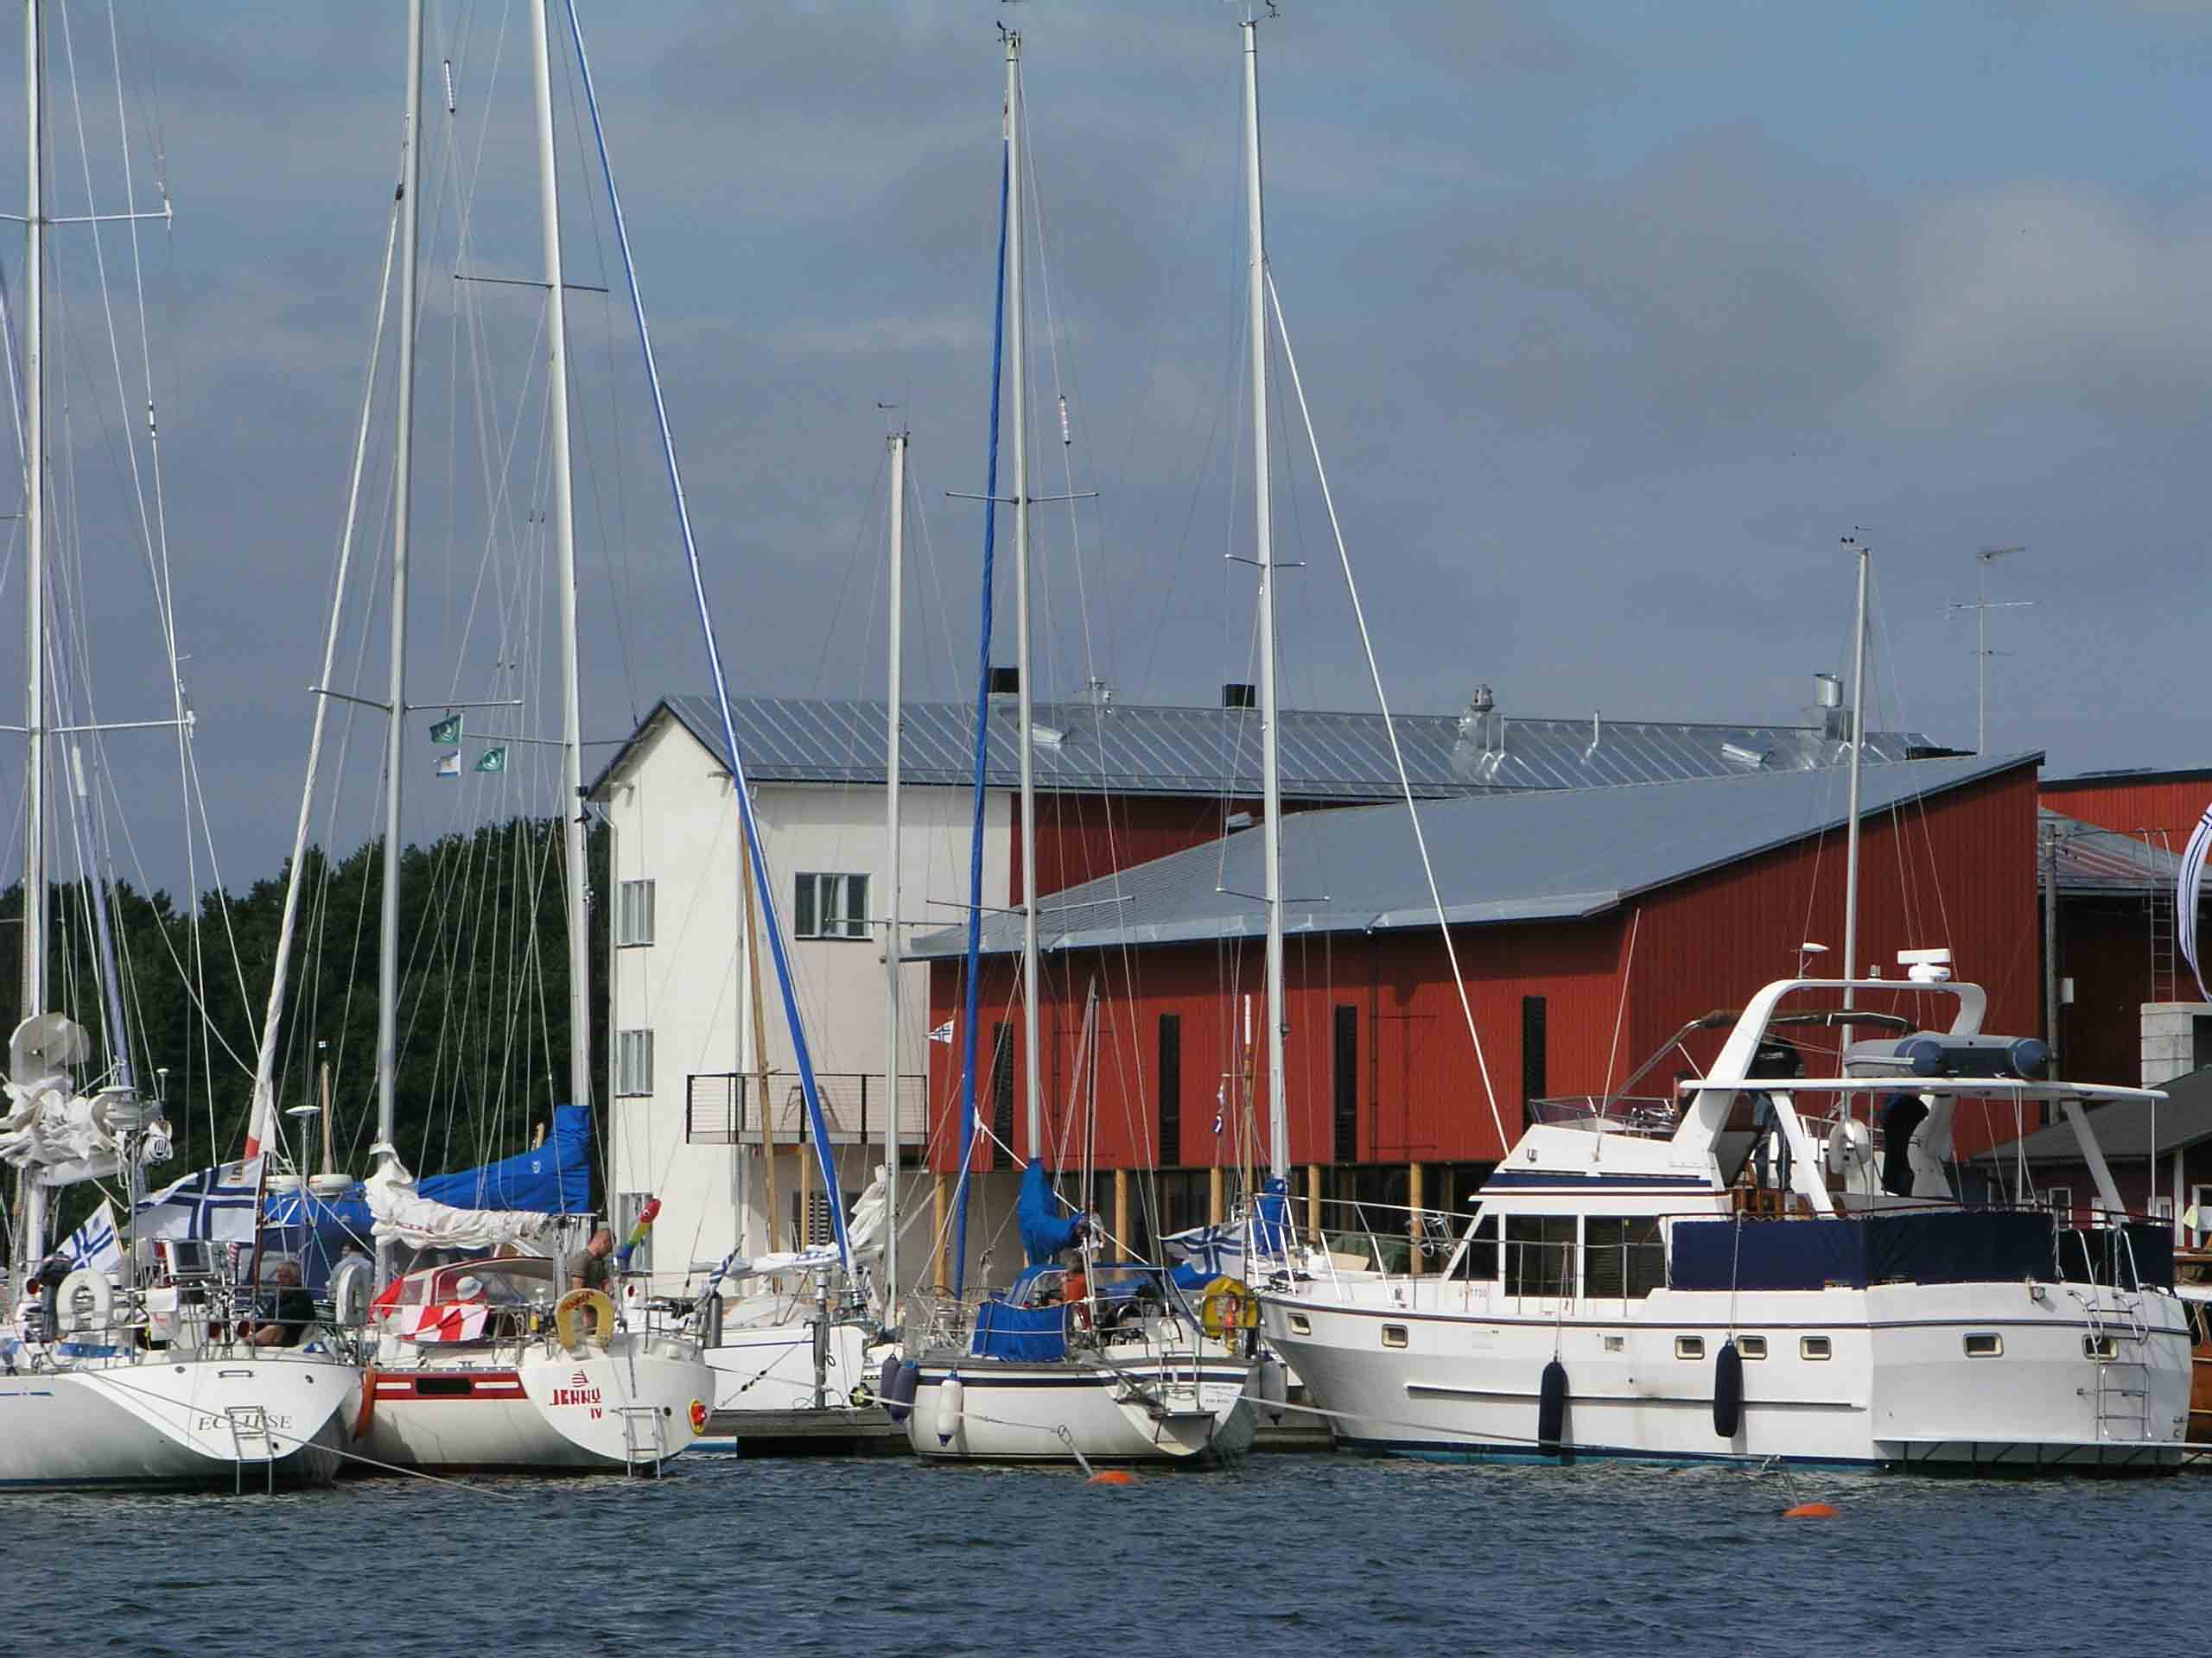
Environmental status, Baltic Sea in the 1970s
Increasing impacts of nutrient loading
  Algae blooms, dead sea bottoms
  Poor sewerage treatment, agriculture,
  energy production, transport
High pollution load of harmful substance
  Marine mammals, fish and seabird populations
  are affected and stressed
  Source industry (PCB, Dioxins), Agriculture (DDT), energy (radionuclides), dumping
Over fishing by industrial fisheries practises
  Industrial fishing methods, trawling
  Fish stocks decline and change composition
Rivers fragmented & ecological flows disrupted
  Hydropower development, water supply, agriculture,
  local land & water use practises changed

Slide 10
State of the Baltic Sea in 2016
Eutrophication significant
  Inputs from land is decreasing
Biodiversity status is inadequate
  Only 3/8 of fish stocks assessed achieve good status
Hazardous substances status is elevated
  EU Ban 2001 on selling fatty fish as food and animal feed
Many emerging issues
  Marine litter (plastics), pharmaceutical residues, underwater sound, health of fish stocks & marine mammals, non-indigenous species, sea transport, toxic sediments, climate change ….
Major restoration needs in watersheds
V1 HELCOM State of the Baltic Sea report 11.07.2017
Notes:
A threat to blue economic development
”None of the open basins of the Baltic Sea has an acceptable ecosystem health status”
In spite of major efforts to address point source pollution & other measures
Face pressure from:
Extensive economic activities
Upstream pollution
Increasing water temperatures
Sea level rise
Acidification
Increased frequency of extreme weather events
Unsustainable fishing practices

Slide 11
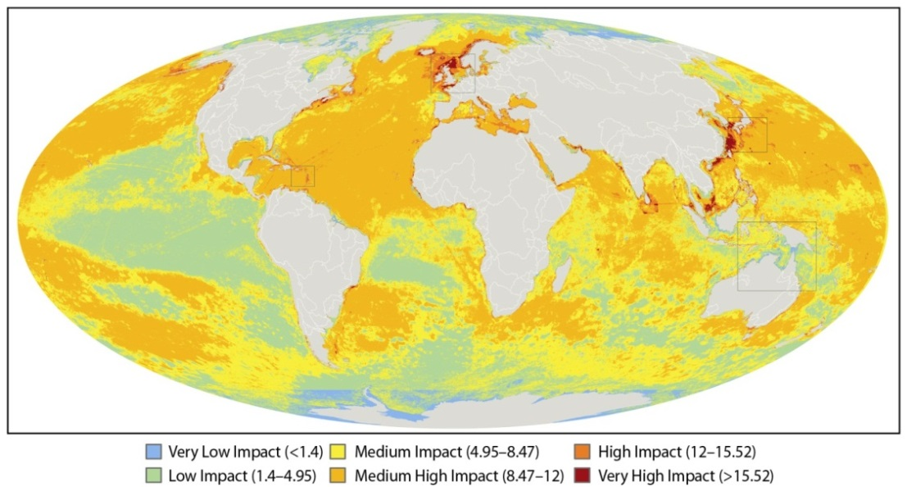
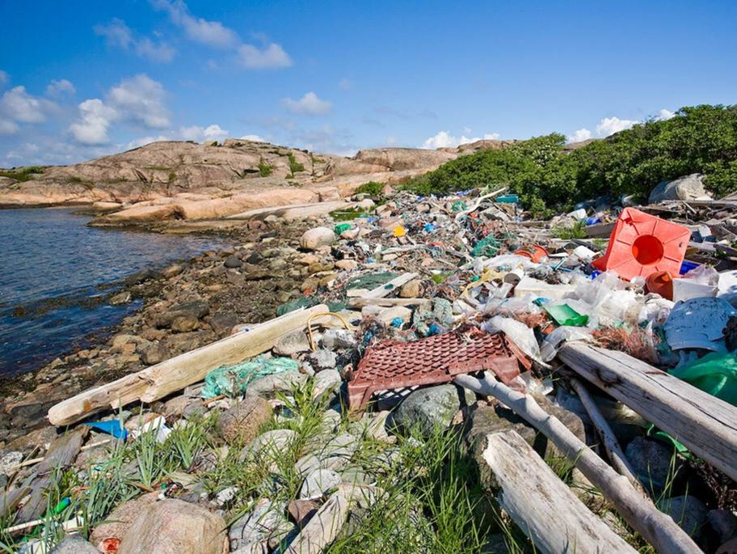
Globally virtually no marine area is unaffected by anthropogenic activities primarily from land
Photo: Ren och Attraktiv Kust
(Based on Halpern et al, 2008)
Notes:
Increasing carbon dioxide emissions and the global spread of industrial pollutants such as mercury and persistent organic pollutants (POPs) are contributing to changes in the chemistry of the ocean (Doney, 2010). The increasing abundance of microplastics and other marine litter puts severe stress on open ocean ecosystems (Joint Group of Experts on the Scientific Aspects of Marine Environmental Protection (GESAMP), 2015).
Halpern et al. (2008) assert that virtually none of the world’s marine areas are today unaffected by human influence and that the largest impacts are felt in those areas subject to both land-based and marine-based human pressures. The excessive loading of nutrients in marine and coastal areas is a major pollution problem globally
Face pressure from:
Extensive economic activities
Upstream pollution
Increasing water temperatures
Sea level rise
Acidification
Increased frequency of extreme weather events
Unsustainable fishing practices

Slide 12
What to do differently?

Slide 13
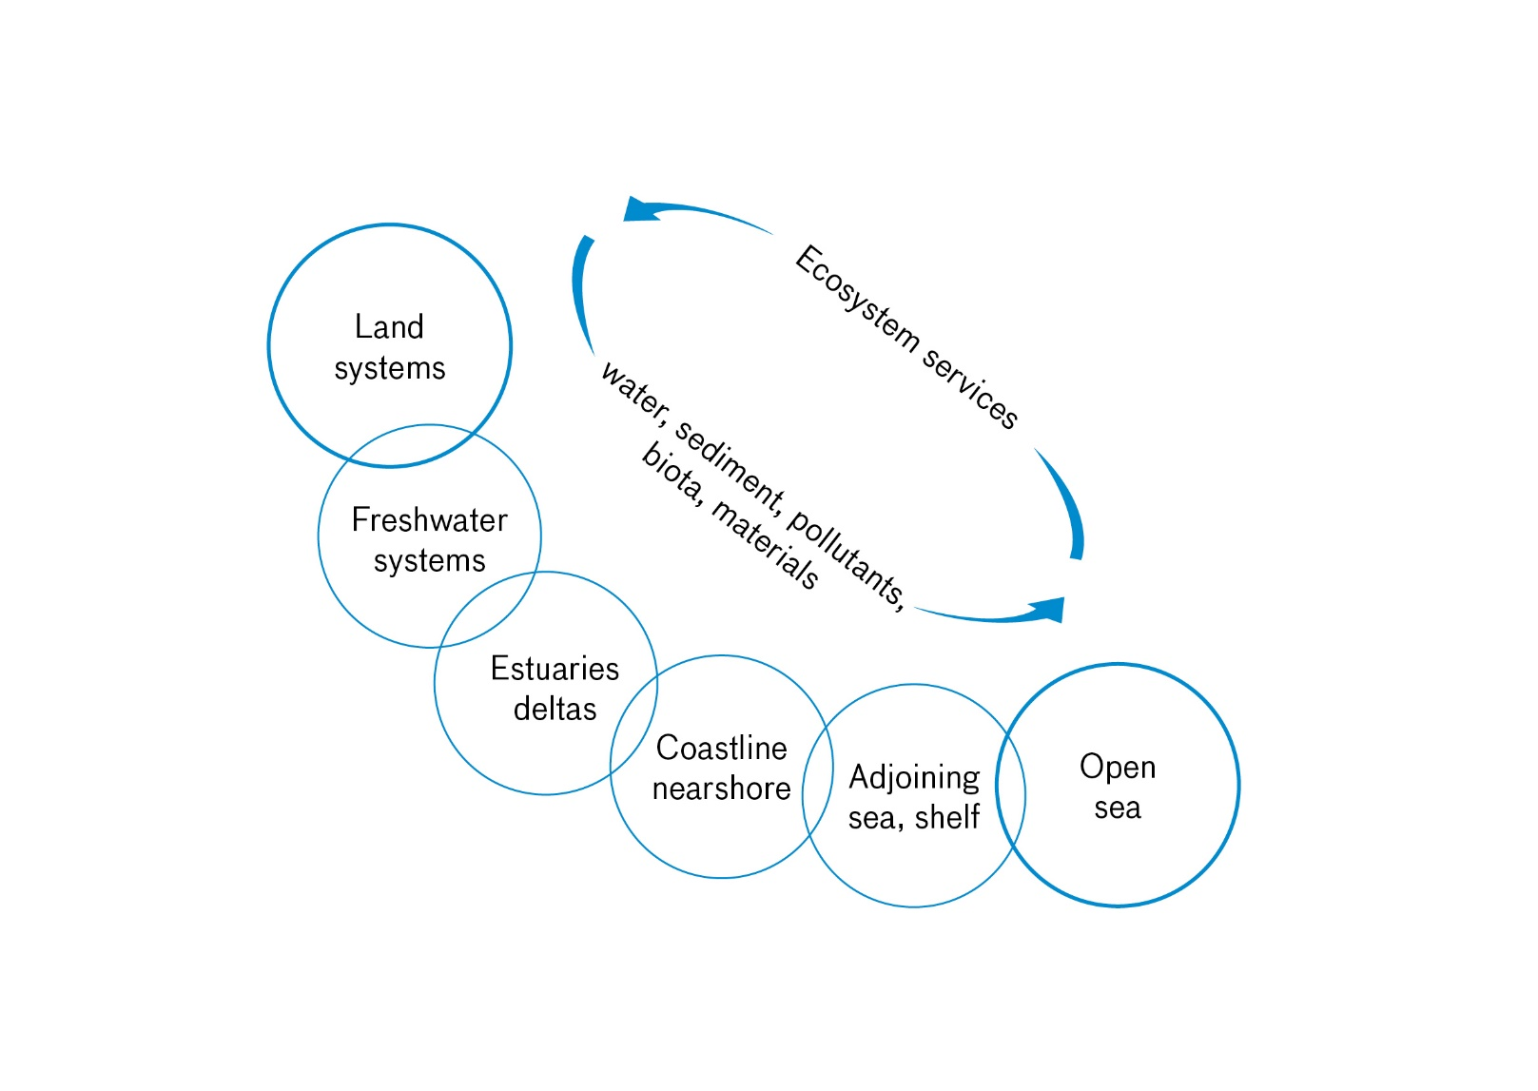

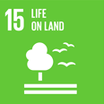

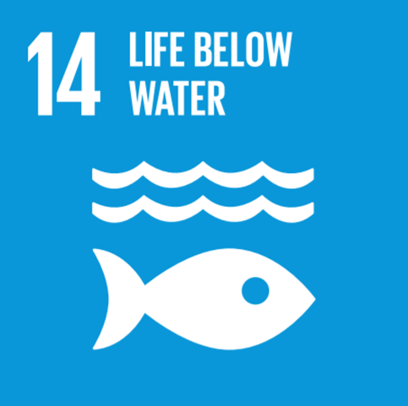
Coordinated governance & management ”from source-to-sea”
Granit, Liss Lymer, Olsen, Tengberg, Nõmmann & Clausen, 2017

Slide 14
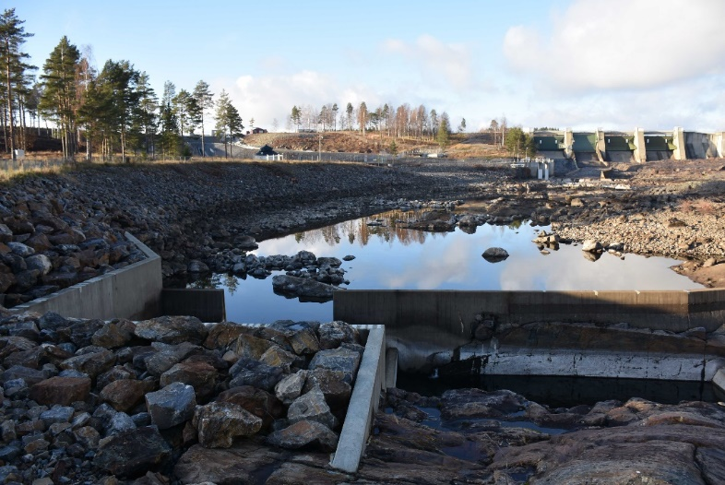
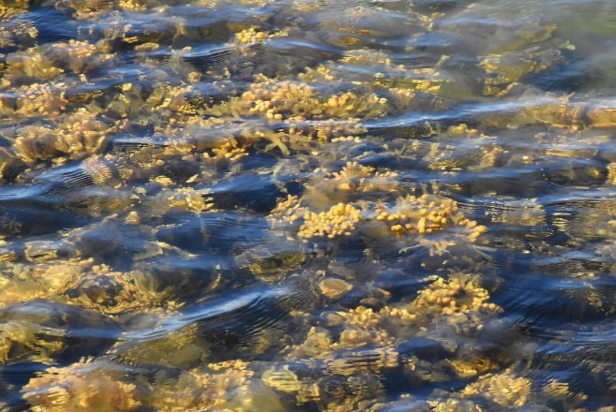
Integrated water management in the Baltic
Sea Region
Based on common EU Water Framework Directive, law in all EU countries!
  National & international river basin management districts
  Agreed plans & programme of measures, monitoring
  Continued engagement with non-EU members
EU Baltic Sea Region Strategy
  Save the sea; connect the region; increase prosperity
Sustainable development challenges
  Development and ecosystem integrity/restoration

Slide 15
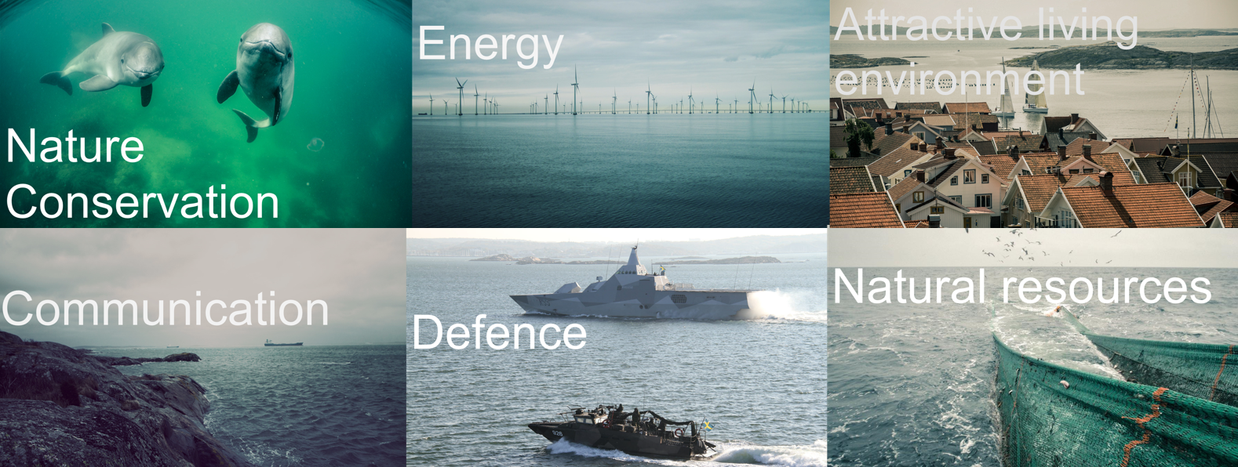
Marine Spatial Planning in the Baltic Sea Region
Common EU marine framework directive & policy

Slide 16
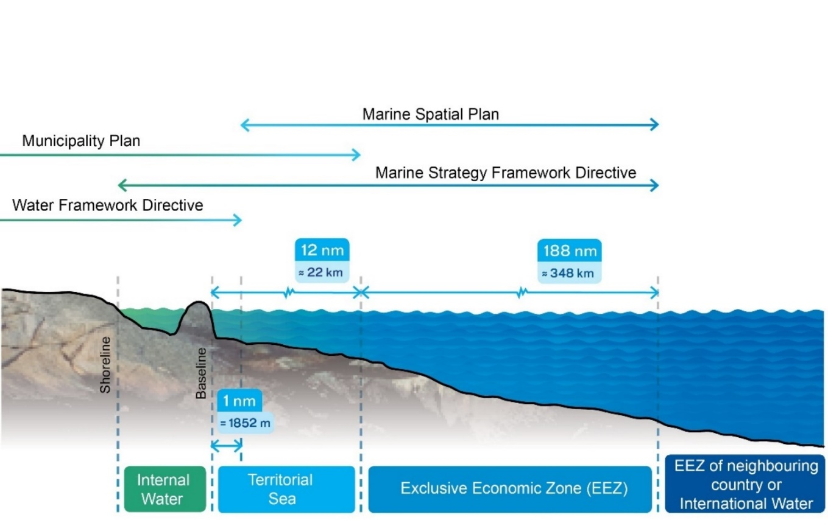
Physical planning - interaction land-sea
Land use & marine spatial planning in a continuum
Contiguous zon
12 nm

Slide 17
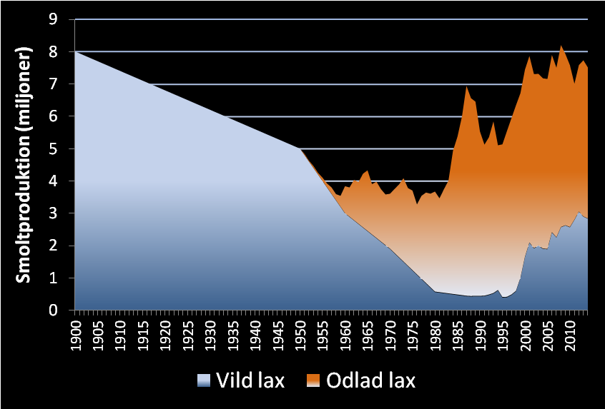
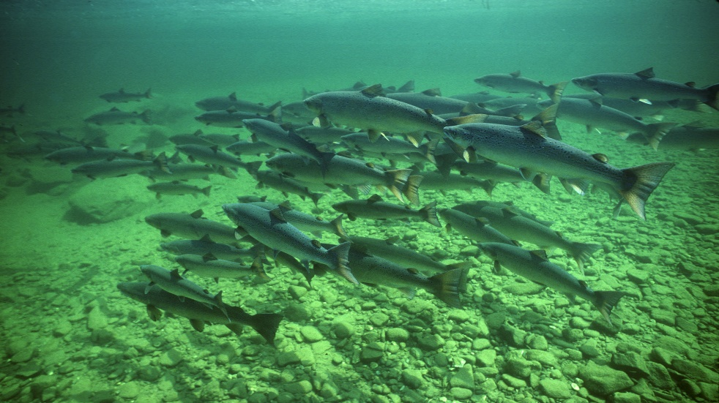
Example: coordinated management of
Baltic sea salmon stocks
Wild salmon
Farmed salmon
Photo courtesy of Gilbert van Ryckevorsel
Exploitation of rivers
High fishing pressure
Low survival, salmon fry disease M74
Restoration of rivers
Lower fishing pressure
Higher survival of salmon fry disease M74
Photo courtesy of Gilbert van Ryckevorsel

Slide 18
Conclusions
From source-to-sea
Notes:
Messy problem, messy decision making
Intensify knowledge, improve decisionmaking, uncertainty
Dynamic systems

Slide 19
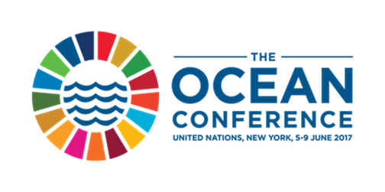

Management in the source-to-sea continuum
System thinking; upstream to downstream; source-to-sea
Coordinate across sectors and geographic segments at multiple scales
Identify clear objectives when tackling ”key flows” & ecosystem services
Build commitment & ownership by stakeholders across sectors!
UN New York, 5-9 June, 2017
Notes:
System thinking; upstream to downstream; source-to-sea
Learn from past cycles of governance
Perspectives: ecosystem, green & blue growth
Encourage Research & innovation
Coordinate across sectors and geographic segments at multiple scales from source-to-sea
Consider how development upstream or downstream impact in the continuum
Integrate planning systems from land to sea
Eg energy development, hydropower, wind, sea, thermal, interconnections, markets
Protected areas on land, coast and at sea
Disaster risk reduction schemes at whole society level
Identify clear objectives when tackling ”key flows”
Water: flood & drought control, water supply and sanitation, make room for water in the landscape, disaster risk reduction, salt water intrusion
Sediments: protect multipurpose functions of dams and reservoirs, protect coastal habitats and coral reefs, ensure navigation
Pollution: reduce marine debris, toxic waste, nutrients & pesticides
Biota: Manage fisheries, protect fish migration & biodiversity, ensure ecosystem flows
Material flows: plan the built environment for climate change, green infrastructre, ensure aesthetic values,
Build commitment & ownership by stakeholders
Local, national, regional levels (eg. Mekong river basin, Regional seas)
Bring green- & blue economic concepts into Regional Economic Frameworks (eg. EU, ASEAN)
Financing frameworks, political risk

Slide 20
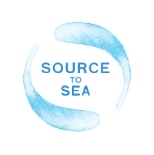

Thank you
@jakobgranit www.havochvatten.se

