Slide 1
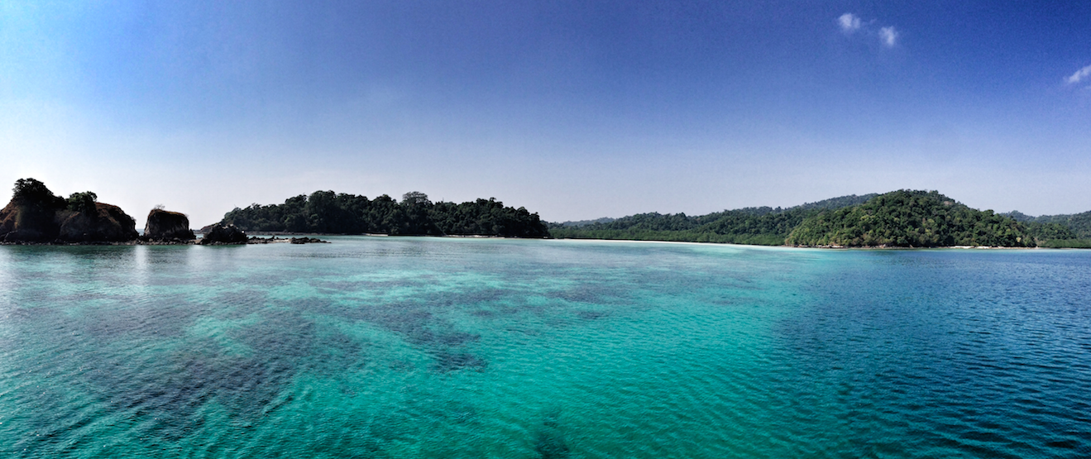
3rd Asia Pacific Water Summit 2017
Source to Sea Opportunities and Challenges in Myanmar
Toe Aung, Assistant Director
Ministry of Natural Resources and Environmental Conservation
December 12th, 2017

Slide 2
S2S Overview
Land-based Management
Water-based Management
Marine and Coastal Management
“Source to Sea”(FAO)
“Ridge to Reef”
Existing approached to environmental protection and development on land, along rivers, and in coastal zones and marine environments struggle to address linkages in the sources-to-sea continuum
Recognizing the need for integrated coastal and freshwater management in the Manila declaration adopted by 65 countries in January 2012

Slide 3
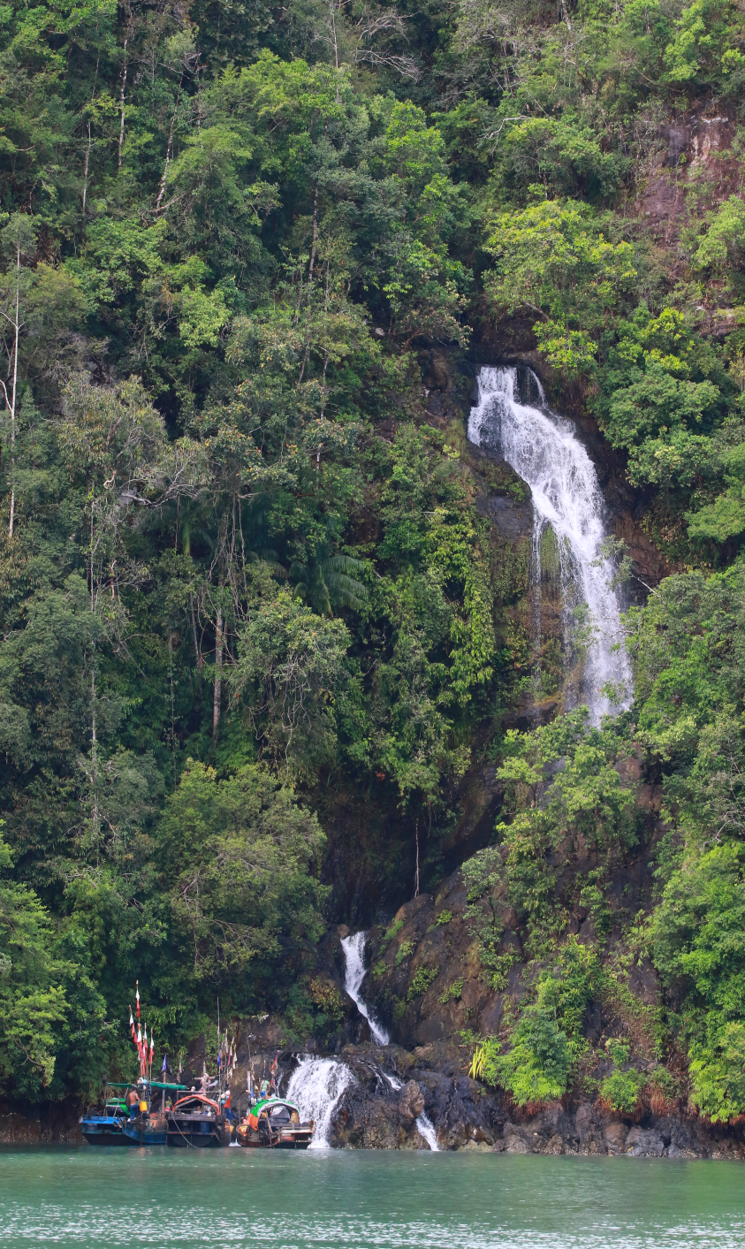
S2S Overview
Land-based Management
Water-based Management
Marine and Coastal Management
Biodiversity Conservation: 39 protected areas
Ten-year Logging Ban for Bago Mountain Range that is home of teak in the world
One-year Logging Ban for the forests of the whole country

Slide 4
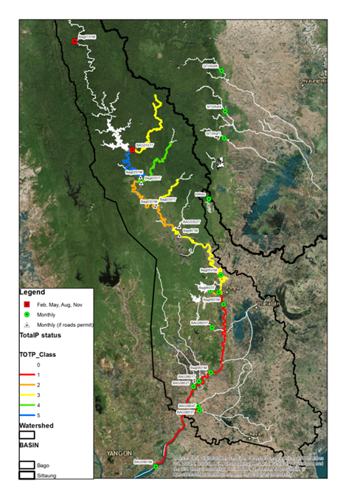
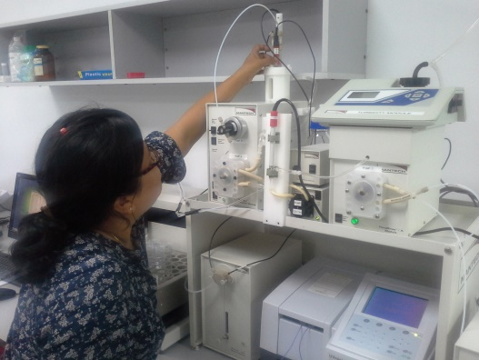
S2S Overview
Land-based Management
Water-based Management
Marine and Coastal Management
Two policy frameworks in Myanmar
National Water Framework Directive (NWFD)
National Water Policy (NWP)
The EU WFD focuses on:
- River Basin Management
Coordination of sector and environmental authorities
Stakeholder involvement
IWRM Project by FD, IWUMD, DWIR and NIVA (Norway)
Piloting the River Basin Management Approach in the Sittaung River Basin
Rehabilitation and instrumentation of the laboratory at FRI
Environmental water quality criteria
Monitoring in Inlay Lake
Water Quality Database

Slide 5
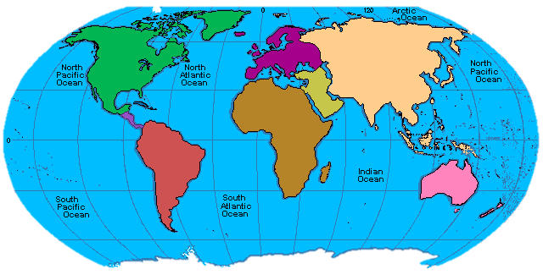
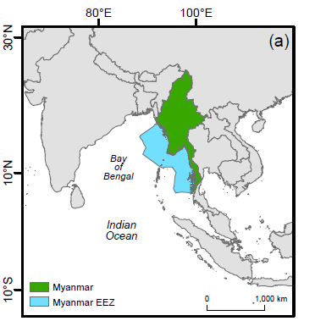
S2S Overview
Land-based Management
Water-based Management
Marine and Coastal Management
Myanmar Coasts and its Natural Resources
The largest conteniental country in Southeast Asia (676, 577 sqkm)
One-fifth of Bay of Bengal Large Marine Ecosystem
Approximately 230, 000 sq. km continental shelf, and 486,000 sq km EEZ
2832 km coast line
Mergui Archipelo- one of the most world’s remote and untouch, made up of over 804 islands
Mangroves, coral reefs and sea grasses
India
India
china
Bangladesh
Laos
Thailand

Slide 6
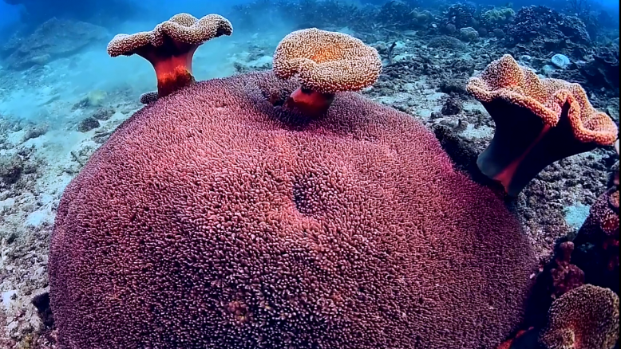
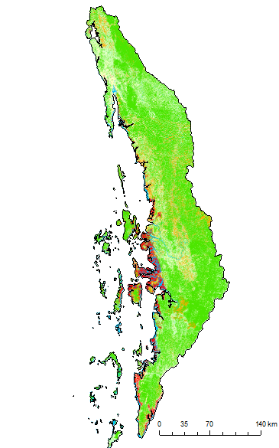
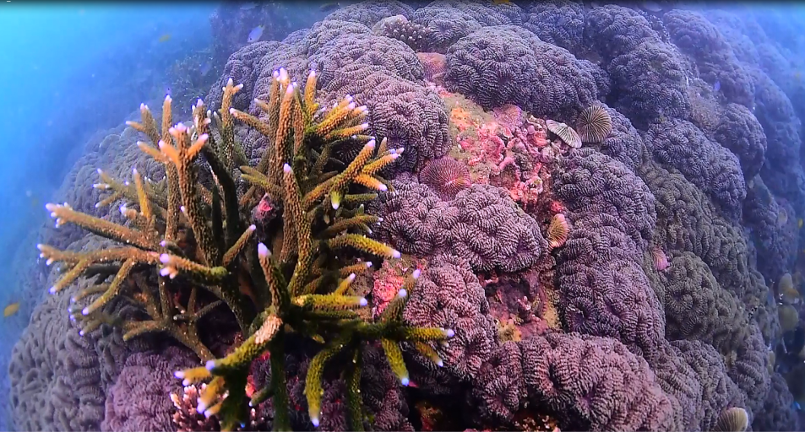
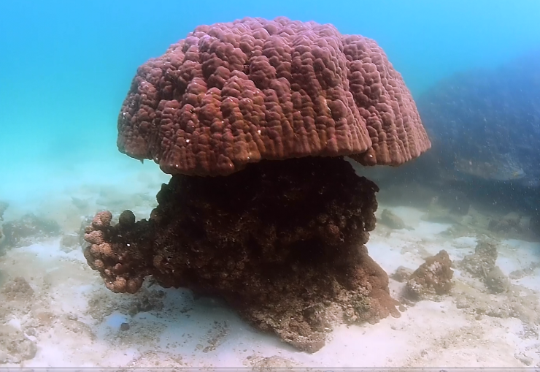
S2S Overview
Land-based Management
Water-based Management
Marine and Coastal Management
Coral Reefs and its associated ecosystems
Habitat Area of Coral Reefs about 187, 000 ha (BOBLME, 2012)
287 Coral Reef Species (NBSAP 2015) up to 512 species by Master and Ph.D studies (NSAP, 2016)

Slide 7
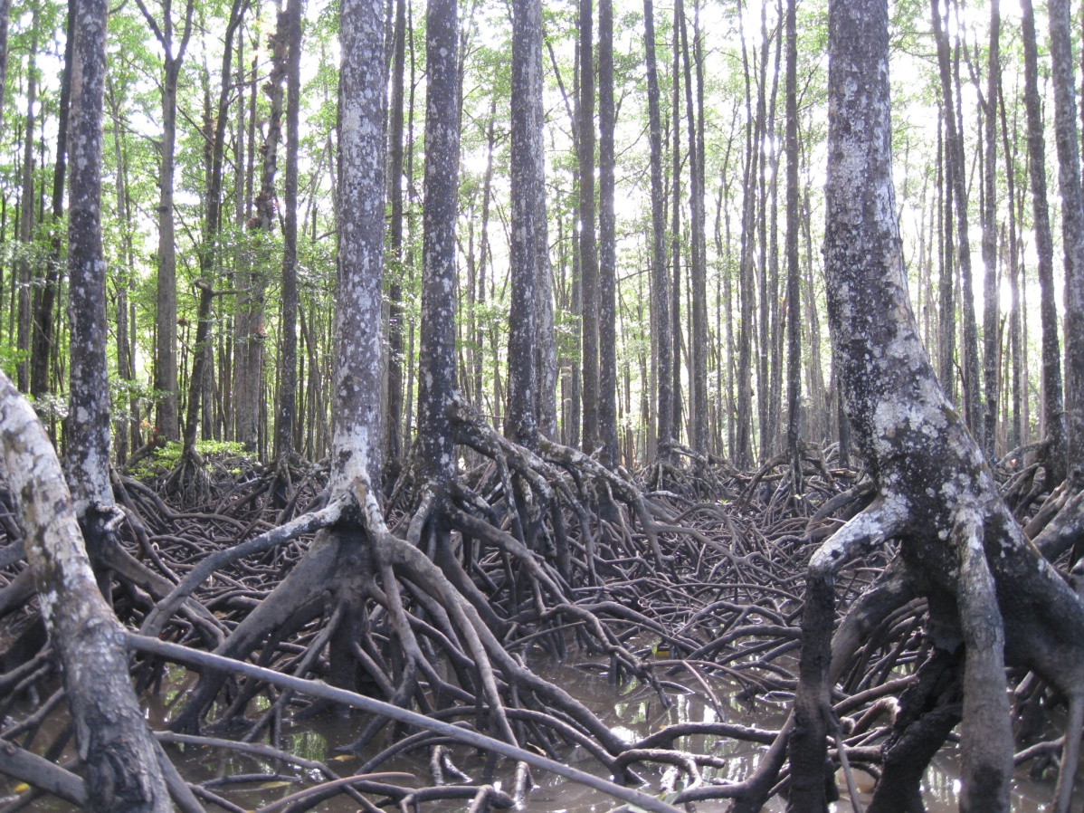
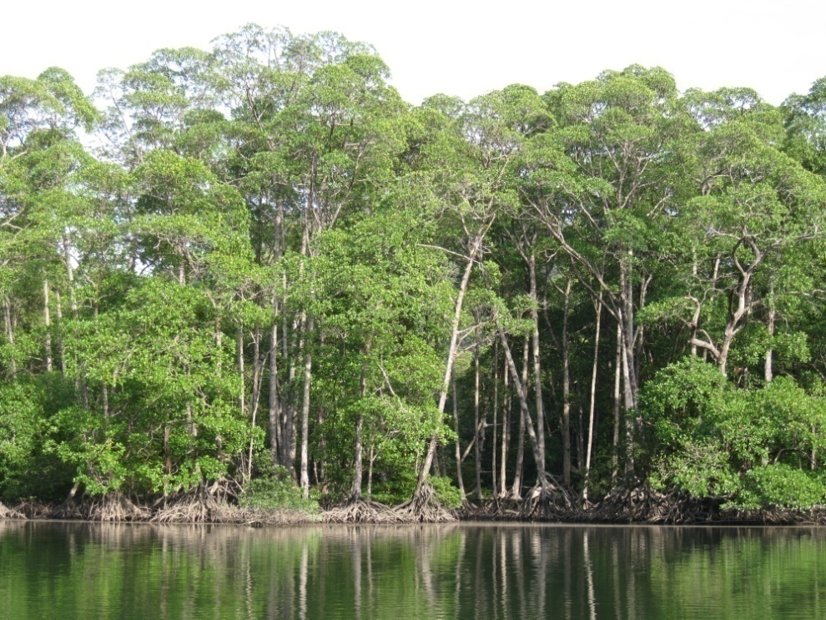
S2S Overview
Land-based Management
Water-based Management
Marine and Coastal Management
Coral Reefs and its associated ecosystems, mangroves
Ranked as seventh largest extent of mangroves worldwide
502,911 hectares/1,242,190 acres
(World Mangrove Atlas 2010)
34 true mangrove species
(Mangrove guidebook for Southeast Asia, 2006;
The World’s mangroves, 2007; World mangroves atlas, 2010)

Slide 8
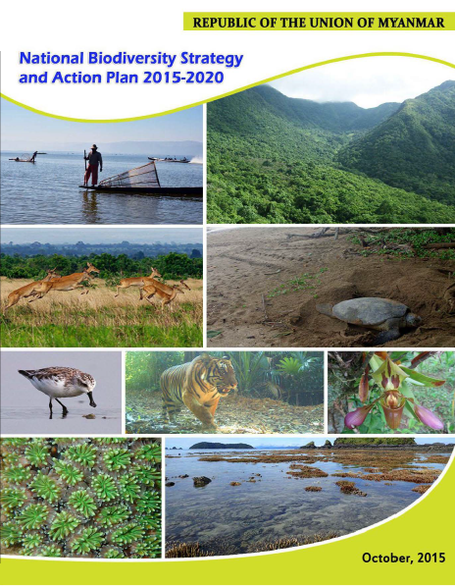
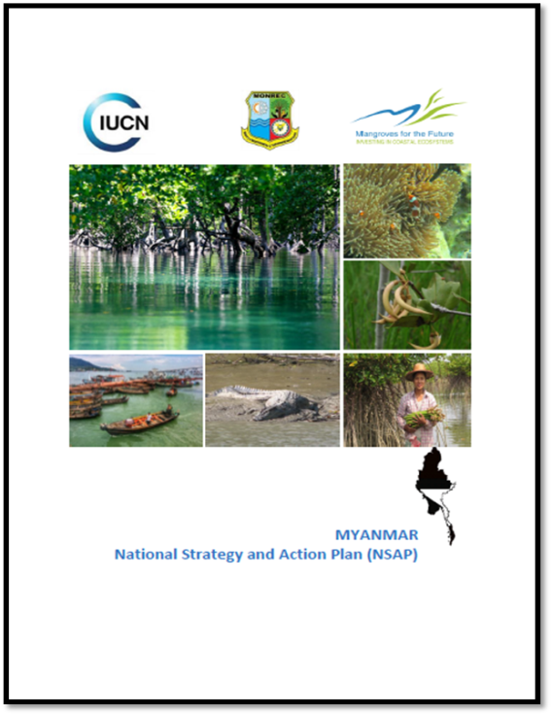
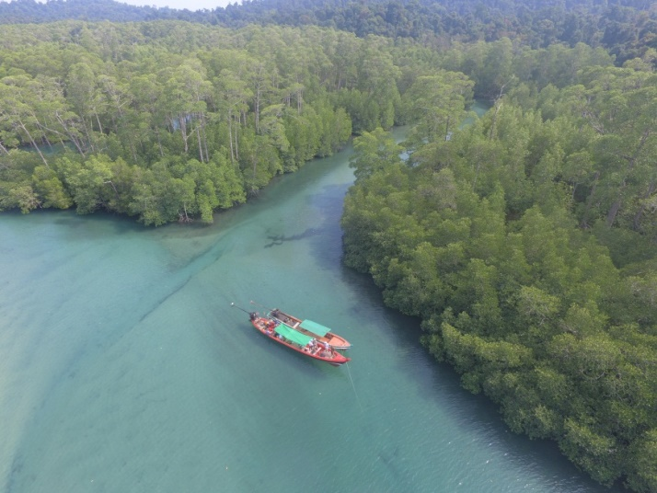
S2S Overview
Land-based Management
Water-based Management
Marine and Coastal Management
Myanmar policies on Marine Resources
NDC and SDGs, Paris Climate Agreement
Reserved Forests/Protected Public Forests 30 % and Protected area systems 10 % of national total land area
NBSAP Aichi Target 6, 10 and 11
15 % of Myanmar's coral reef
10 % of marine and coastal areas
LMMA and MPA
NSAP for MFF
Environmental Profiling
Capacity Building
ICM Development
Civil Society Engagement
MPA Management
Notes:
Not starting from scratch

Slide 9
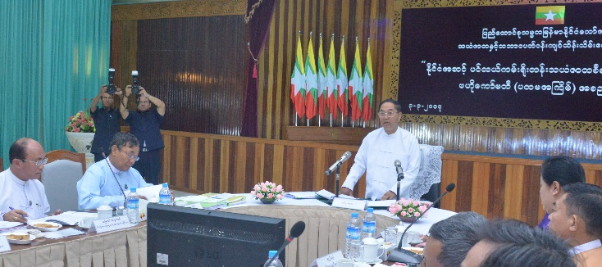
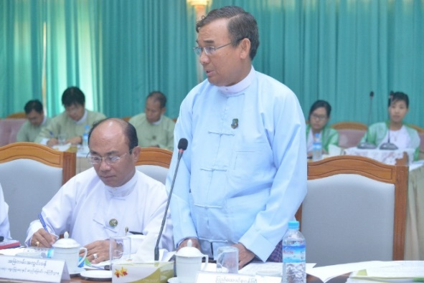
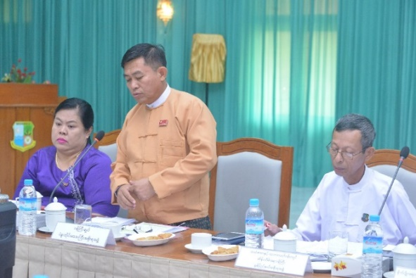
S2S Overview
Land-based Management
Water-based Management
Marine and Coastal Management
A milestone approach to marine and coastal conservation; National/High-level Platform
Led by Vice President, NCRMC
National Coastal Resources Management Committee (30th November, 2016)
The first ever highest level coordination mechanisms
Vice President
(19) Member National Platform
Two ministers from Forestry and Fishery Sectors
Six Chief Ministers from Coastal States and Regions
(7) Permanent Secretaries from relevant ministries
Navy Official for Coastal Guard
Two DGs from Forestry and Fishery

Slide 10
To conclude,
How to link all three land-based, water-based and marine-based management?
Challenges for S2S!
S2S Overview
Land-based Management
Water-based Management
Marine and Coastal Management
A linkage between two national level platform, NWRC and NCRMC?
Regardless of administrative boundaries, how to go basin-based collaboration?
Upstream and downstream/marine linkages, willingness to pay for environment services?

Slide 11
Thank you very much for your kind attention!
If there are any questions:
Toe Aung, Ph.D
Assistant Director, Mangrove Conservation Unit
Forest Department, Ministry of Natural Resources and Environmental Conservation, Nay Pyi Taw, Myanmar
Email: toeaung02@gmail.com, Facebook: Kyar Pauk
Tel: +9567 405398, + 959 4004 95597
Fax: +9567 405398

